Slide 1


Slide 2

#LifeKoKaroLift
SGC Coaching:
Articulate your Journey | Activate Your Vigour| Accelerate Mutual Growth
Session 17
POS Tagging

Slide 3
Agenda
Quick Recap – (15 min)
Focused Teaching (60 min)
Lexical Processing
doubts resolutions
Last 2 weeks
Doubts Resolutions (15 min)

Slide 4
Recap: What the learner have learnt in the week
Quick Glance at Key Learnings
Basic NLP
Lexical
TF-IDF
When to use
What is BOW
When to use BOW
When to use
What is
Basics

Slide 5
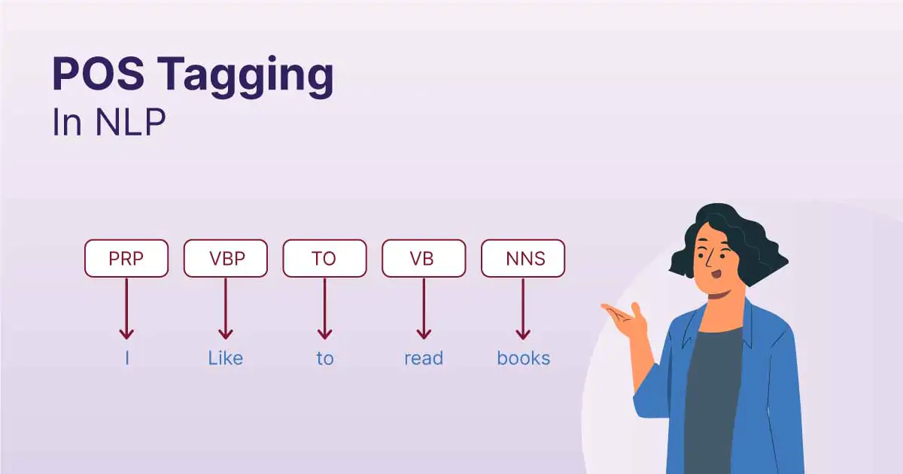
POS-tagging:

Slide 6
POS-tagging:
Understand the grammatical structure
Disambiguate words with multiple meanings
Improve the accuracy of NLP tasks
Facilitate research in linguistics

Slide 7
POS-tagging: Use-cases
Information extraction
Named entity recognition
Text classification
Machine translation
Natural language generation

Slide 8
Coding Time
Coding Time
Notes:
Coding time

Slide 9

Doubts Resolutions

